Slide 1
Cyber Threat Intelligence Report
By: SAMIKSHA REGMI
TUTOR: CLINTON HAYES UNIT COORDINATOR: Jamie SHIELD

Slide 2

BlackCat (ALPHV)
It is a Ransomware-as-a-Service (RaaS) group.
Is effective and hard to detect.
It targets critical industries including healthcare.
Financial gain from ransomware campaigns serves as motivation.

Slide 3
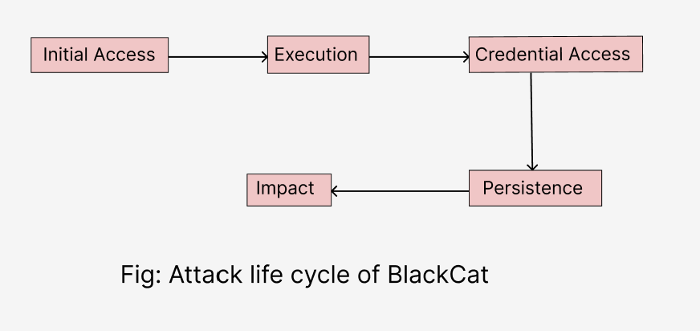
Attack lifecycle of BlackCat

Slide 4
Attack Lifecycle of BlackCat
Initial Access: BlackCat exploits stolen credentials and MoveIt vulnerabilities.
Execution: Uses Windows utilities to deploy malware.
Persistence: Set up scheduled tasks to maintain access.
Credential Access: Steals credentials to escalate privileges.
Impact: Encrypts files and demands a ransom.

Slide 5
BlackCat Attack Techniques & Tactics
Sub/ Techniques Used
T1078 - Valid Accounts (Initial Access): BlackCat obtains initial access by using credentials that have been stolen or compromised.
T1059.003 - Windows Command Shell (Execution): Commands executed using Windows Command Shell to distribute the ransomware payload.

Slide 6
BlackCat Attack Techniques & Tactics
T1053.005 - Scheduled tasks (Persistence): These are designed to keep access open even after system reboots.
T1003 - OS Credential Dumping (Credential Access): Credentials are pushed laterally and at higher levels of privilege.
T1486 - Data Encrypted for Impact (Impact): Systems become inoperable due to the encryption of files, requiring payment of a ransom.
(https://www.hhs.gov/sites/default/files/blackcat-analyst-note.pdf)

Slide 7
Why These Sub/Techniques?
Valid Accounts (T1078): We can get around security measures and get direct access by stealing credentials.
Windows Command Shell (T1059.003): To avoid detection by security systems, we use native tools.
Scheduled Tasks (T1053.005): This ensures our malware persists on the system, even after reboots or partial cleanups.

Slide 8
Why These Sub/Techniques?
Credential Dumping (T1003): To obtain more sensitive data and higher privileges, we extract credentials.
Data Encryption (T1486): The victim must pay a ransom to restore operations when important files are encrypted.

Slide 9
Vulnerabilities Detected
1. SSL Medium Strength Cipher Suites Supported (SWEET)
CVE-2016-2183: Takes use of 3DES's flaws to potentially decrypt data during lengthy sessions.
Disabling medium-strength cyphers and 3DES is the solution.

Slide 10
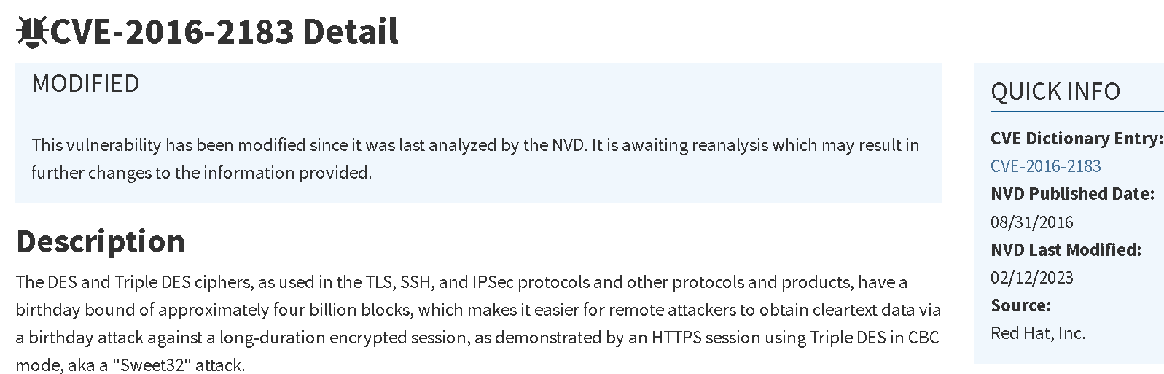
1. SSL Medium Strength Cipher Suites Supported (SWEET)

Slide 11
Vulnerabilities Detected
2. Chargen UDP Service DoS:
CVE-1999-0103: By overloading the Chargen service with requests, this vulnerability permits Denial of Service (DoS) attacks.
Disabling the Chargen service is the solution.

Slide 12
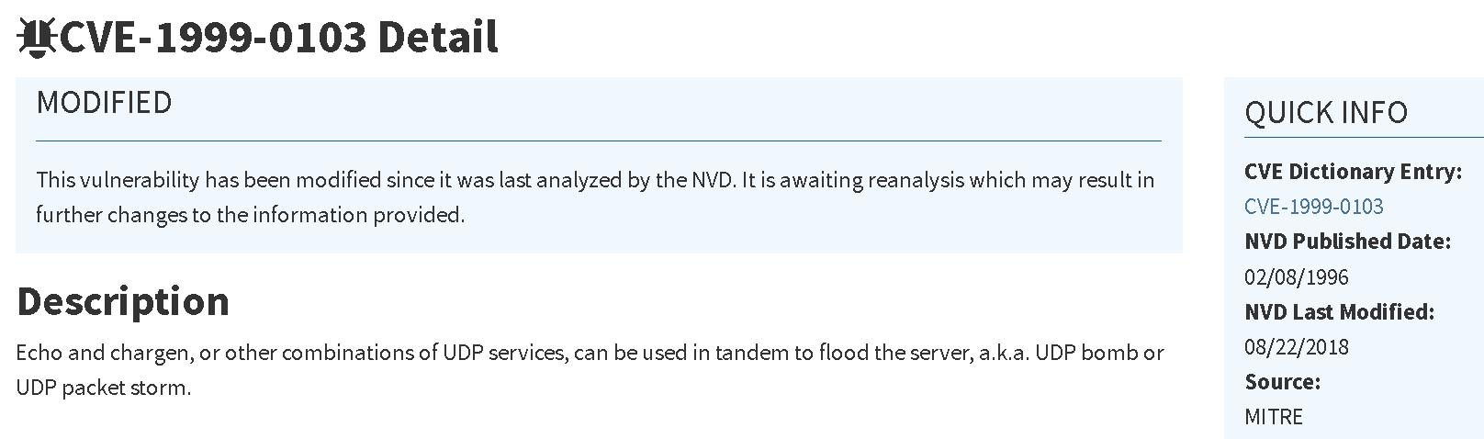
Report

Slide 13
Vulnerabilities Detected
3. Echo Service Detection:
CVE-1999-0103, CVE-1999-0635: Abuse potential includes reflected DoS attacks and excessive network traffic.
Turn off the Echo service as a solution.

Slide 14
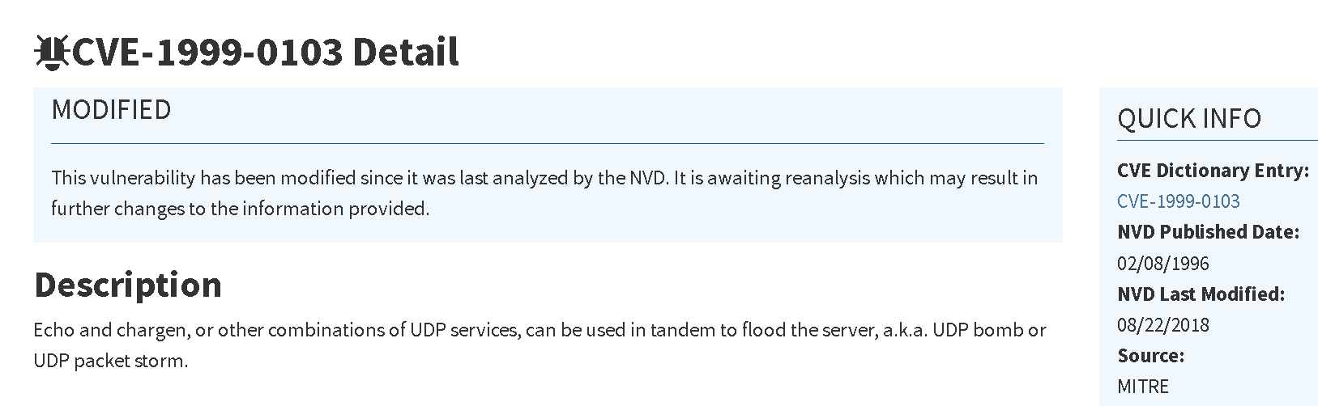
Report

Slide 15
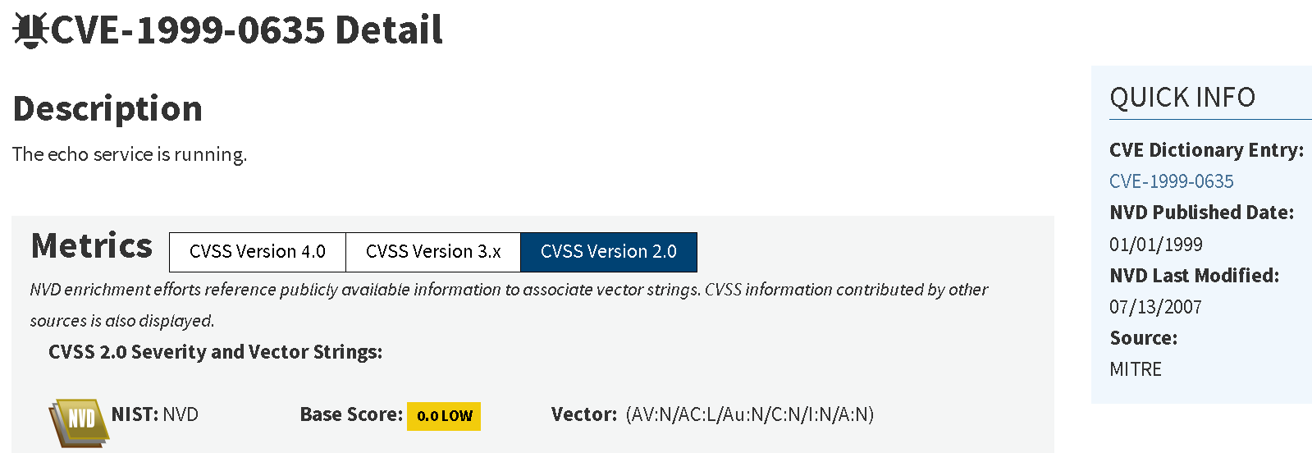
Report

Slide 16
Vulnerabilities Detected
4. SMB Signing Not Required:
CVE-2012-1185: In the event of an MITM attack, SMB traffic can be intercepted or altered.
Enforce SMB signing as a solution.

Slide 17
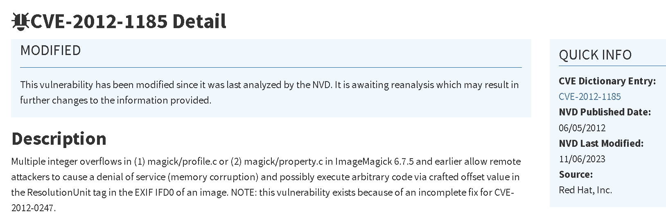
Report

Slide 18
Vulnerabilities Detected
5. TLS 1.0/1.1 Protocol Detection:
CVE-2011-3389 (BEAST), CVE-2014-3566 (POODLE): Vulnerable to decryption attacks are outdated TLS versions.
The fix is to enforce TLS 1.2/1.3 and disable TLS 1.0/1.1.

Slide 19
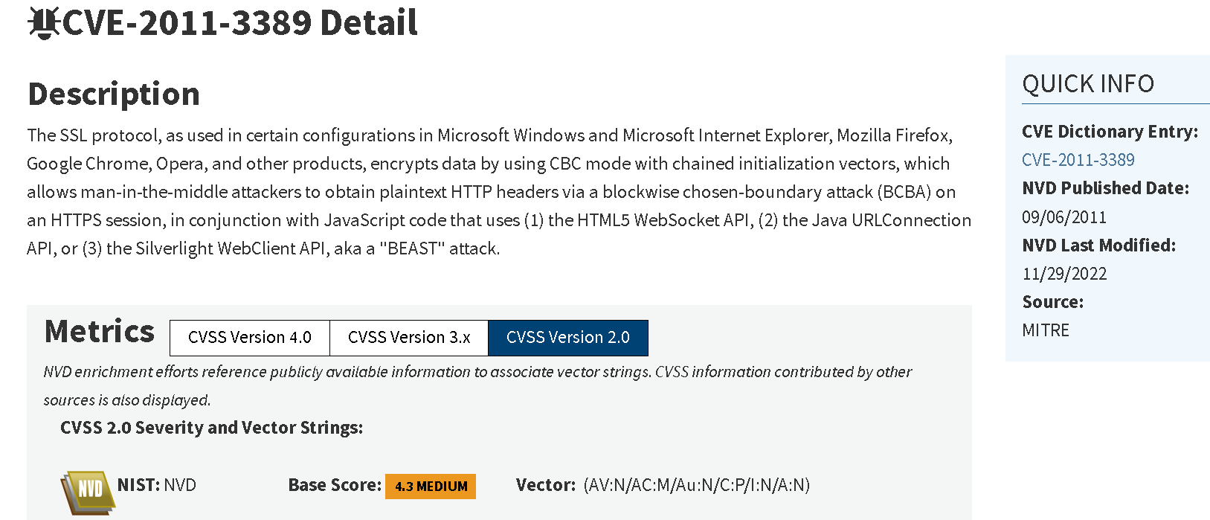
Report

Slide 20
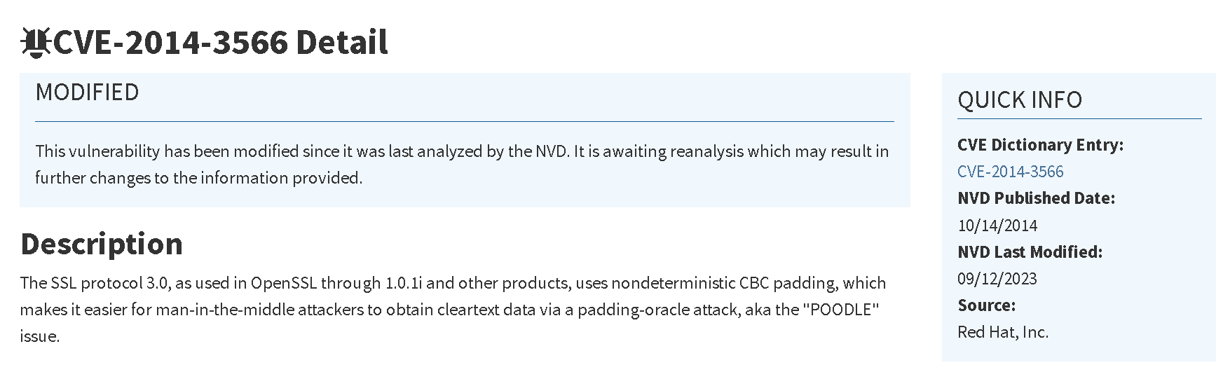
Report

Slide 21
Mitigation Strategies
Address MoveIt and other software vulnerabilities right now.
Enforce SMB Signing: To guard against MITM attacks, make sure all SMB communications are signed.
Turn off Legacy Services: Unused services like Chargen and Echo should be turned off.
Make sure that only secure TLS versions are being utilised by upgrading to TLS 1.2/1.3.
Strengthen account security to thwart credential theft by implementing multi-factor authentication (MFA).

Slide 22
Next Step
Put recommended mitigation techniques into practice.
Conduct penetration testing and vulnerability scans regularly.
Provide phishing and ransomware protection training to staff members.

Slide 23
References
Health, U. D. (2022). HC3: Analyst Notes. Black Cat AKA ALPHV. (https://www.hhs.gov/sites/default/files/blackcat-analyst-note.pdf)
(2023, February 28). Black CAT. Retrieved from MITRE ATT&CK: ( https://attack.mitre.org/software/S1068/ )
Microsoft.com. (2023). Vulnerability CVE-2016-2183 - Microsoft Q&A. [online] Available at: https://learn.microsoft.com/en-us/answers/questions/1371601/vulnerability-cve-2016-2183 [Accessed 22 Sep. 2024].
nvd.nist.gov. (n.d.). NVD - CVE-2016-2183. [online] Available at: https://nvd.nist.gov/vuln/detail/CVE-2016-2183.

